Slide 1
Supporting your well being

Slide 2
What is Being Well?
Being Well is our colleague wellbeing offering supporting colleagues’ mental, physical and financial health.
The Being Well site is the home of your colleague benefits.
The website groups together your benefits under Anchor’s 5 pillars of wellbeing: money, health, values, belonging and growth.
Find out more by:
Visiting www.AnchorBeingWell.co.uk
Looking out for the latest news in the Reward & Benefits group on Workplace
Notes:
Caring for colleagues' wellbeing is a key theme in our Business Plan. #ListeningAndActing on colleagues saying they wanted to know more about our benefits, we created Being Well and have been adding more and more resources ever since. While some of the benefits of Being Well are only available to contracted colleagues, many of the resources on the Being Well website itself are accessible to non-contracted colleagues too.

Slide 3
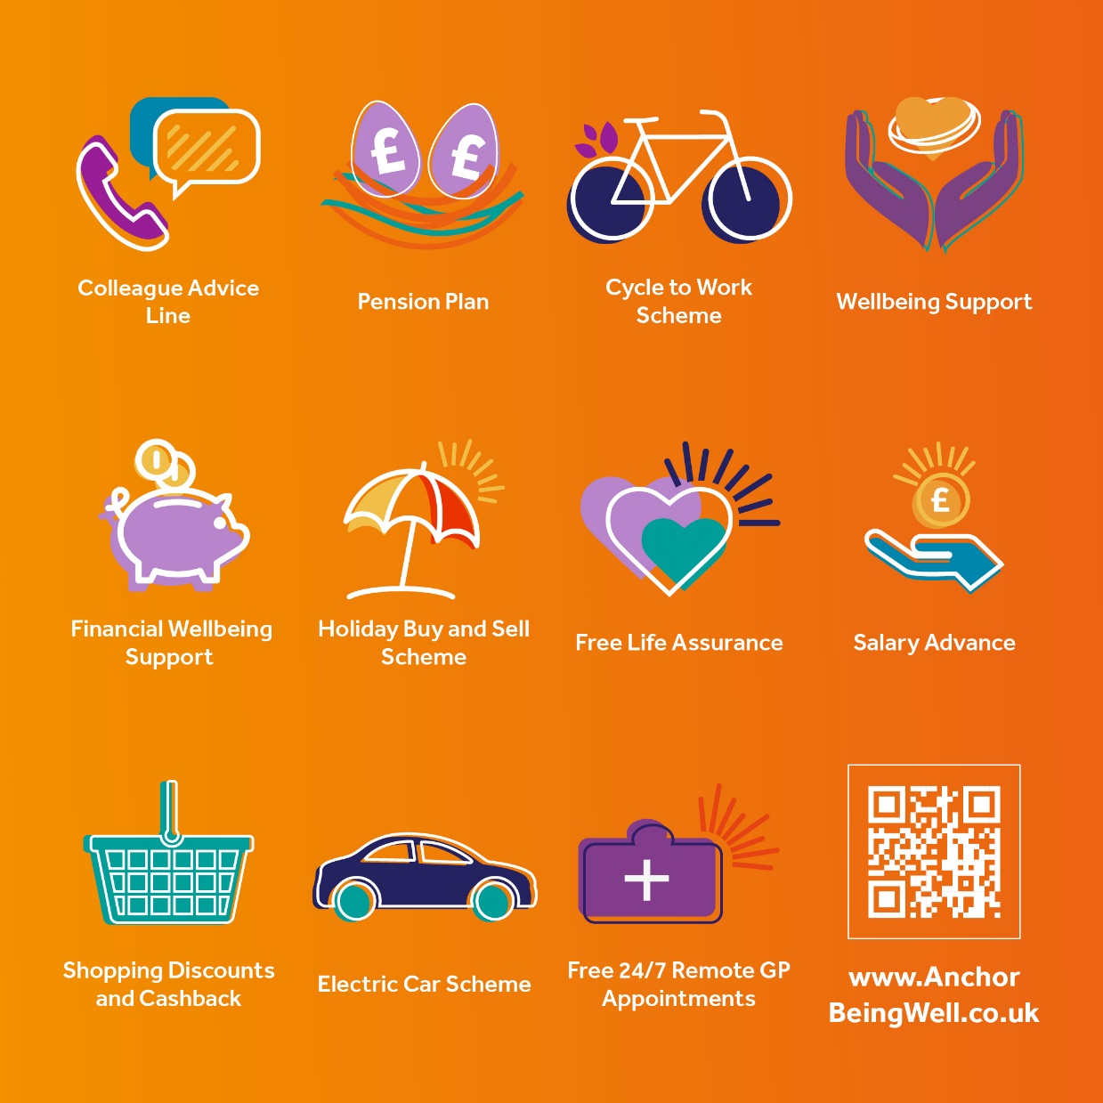
There’s lots available as part of Being Well - take a look any time, by visiting www.AnchorBeingWell.co.uk
Notes:
Being Well is one of the perks of working for Anchor, so do take a look at the website and see what you could be benefitting from to help your mental and physical health, as well as your financial health. Encourage your team to share experiences.

